Slide 1
ClimateScanner
O que eu preciso saber?

Slide 2
— desconhecido
“Se você não consegue explicar algo de modo simples, é porque não entendeu bem a coisa.”

Slide 3
Do simples ao complexo
3

Slide 4
ClimateScanner – Scanner do Clima
Escanear
Passar algo para formato digital; digitalizar um documento, foto, imagem etc., usando um escâner (scanner); digitalizar: escanear um livro antigo.
Clima
Não vamos “escanear” o clima no sentido das condições atmosféricas/meteorológicas.
O que vamos escanear?
As ações governamentais relacionadas ao clima.

Slide 5
Quais ações especificamente?
Governança
Políticas Públicas
Financiamento Climático

Slide 6
Eixo da Governança
Categories | Components
Institutionalization | G1. Legislation framework
 | G2. Government structure
Strategy | G3. Planning
 | G4. Risk management
Coordination | G5. Horizontal and vertical coordination
 | G6. Stakeholder engagement
Accountability | G7. Monitoring mechanisms
 | G8. Transparency
 | G9. Inclusiveness
 | G10. Oversight and climate litigation
Notes:
The purpose of this slide is to:
Briefly comment on the ten components that were chosen to compose the Governance Axis
Suggestion: commenting on the categories instead of the components is a good way to give a quick overview on the axis without going into much detail

Slide 7
Eixo Políticas Públicas
Categories | Components
International commitment | P1. Nationally Determined Contribution (NDC)
General strategies | P2. Mitigation Strategy
 | P3. National Adaptation Plans
Sectoral components | P4. Mitigation sectors
 | P5. Adaptation sectors
Notes:
The purposes of this slide are to:
Briefly comment on the five components that were chosen to compose the Public Policies Axis
Suggestion: commenting on the categories instead of the components is a good way to give a quick overview on the axis without going into much detail
Specifically for this axis, it might be a good opportunity to explain the approach: this axis uses a branching structure that goes from broad commitments (NDC) to sectoral policies created for fulfilling those commitments

Slide 8
Eixo Financiamento
Categories | Components
Goals | F1. Domestic climate finance goals
 | F2. International goals – provider countries
 | F3. International goals – recipient countries
Management and execution | F4. Financial tracking and reporting of climate finance
 | F5. Private climate finance mechanisms
Notes:
The purposes of this slide are to:
Briefly comment on the five components that were chosen to compose the Public Policies Axis
Suggestion: commenting on the categories instead of the components is a good way to give a quick overview on the axis without going into much detail
Specifically for this axis, it might be a good opportunity to explain there is a component specifically designed for provider countries and another for recipient countries, in which we look into the mechanisms that developed countries’ governments have put in place to mobilize international financial flows for climate action in developing countries, and the preparation of such countries to receive and utilize the resources received

Slide 9
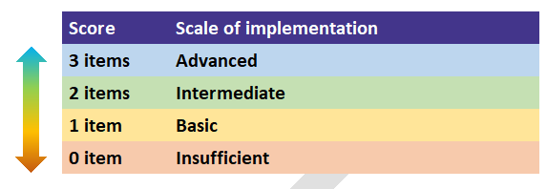
Os componentes foram escolhidos pelo Grupo Executivo porque foram considerados questões prioritárias comuns entre as nações.
Os componentes são assessados de acordo com uma escala de implementação e todos precisam de evidências.

Slide 10
2023 – Fase do design Grupo Executivo: 18 ISCs
Observadores
United Kingdom United Arab Emirates
Equipe coordenadora
Metodologia
Equipe de desenvolvimento de capacidades
Equipe Governança
Equipe Finanças
Equipe Políticas Públicas
Intosai (Brazil)
Intosai WGEA (Finland)
Brazil
Maldives
India
Indonesia
Thailand
Colombia
USA
New Zealand
Brazil
Morocco
ECA
Slovakia
Brazil
Canada
Finland Kenya
Brazil
Chile
Philippines
Notes:
The purposes of this slide are to:
Explain that there is an Executive Group of 18 SAIs working together to develop the ClimateScanner rapid review methodological framework
Show the countries/jurisdictions represented by the participating SAIs
Explain the reason we are developing the methodology with so many countries is to absorb different perspectives in designing the tool’s approach. The Group has representatives from all continents; representation from Small Island Developing States; Annex I, Non-Annex I and Annex II countries etc.
Show the division of roles within the group according to the axes of the methodology: governance, finance and public policies
Communicate there is also a fourth team dedicated to the capacity building aspect of the project. This team is responsible for designing a survey for collecting data from SAIs in order to map needs for training in applying the ClimateScanner tool and propose capacity building activities for that

Slide 11
Além disso…

Slide 12
01
02
Survey
Capacitação
03
04
Plataforma
Workshops
Intuito de identificar as necessidades de treinamento em questões relacionadas às mudanças climáticas
Capacitar as ISCs ao redor do mundo para usar a ferramenta em 2024
Plataforma aberta ao público com dados confiáveis
Workshops de capacitação para os grupos regionais

Slide 13
Project schedule
2022
Planning phase
Project design
Publicizing and networking
Official launch (XXIV Incosai, Rio, NOV/22)
2023
Design phase
Tool design
Global survey on SAIs’ capacities
Pilot tests
Finalization
2024
Execution phase
Global call
Capacity building
Use of the tool by SAIs
Consolidation and communication
Notes:
The purposes of this slide are to:
Comment that the timespan of the project covers three years, from 2022 to 2024
Inform that, in 2022, we conducted the planning phase, in which we designed the project and main outcomes until 2024, interacted with stakeholders to publicize the project and establish partnerships, and held the official launch of the project in global level during the INCOSAI, in Rio de Janeiro, Brazil
Inform that we are currently working on the design phase, in which the Executive Group of 18 SAIs is developing, testing and adjusting the methodology. During the design phase, we have also prepared a global survey with the purpose of collecting data from all INTOSAI member SAIs in order to identify their needs in terms of training to run the tool in 2024. This is also a good moment to mention the ClimateScanner methodology will be presented at UNFCCC COP 28.
Give an overview on the activities planned for the 2024, under the execution phase. Alert that the schedule and activities for 2024 are still subject to change. We are aiming to hold a global call event early 2024 to present the final version of the tool and invite SAIs to participate and apply the tool in their nations. In order to do that, we will provide courses to auditors so they understand how to use the tool and conduct the assessments. The period for execution is estimated to cover the 2nd and 3rd quarters of 2023. In the last months of 2024, the Executive Group will consolidate results and prepare communication products. We also aim to present the final results of the initiative at UNFCCC COP 29.

Slide 14
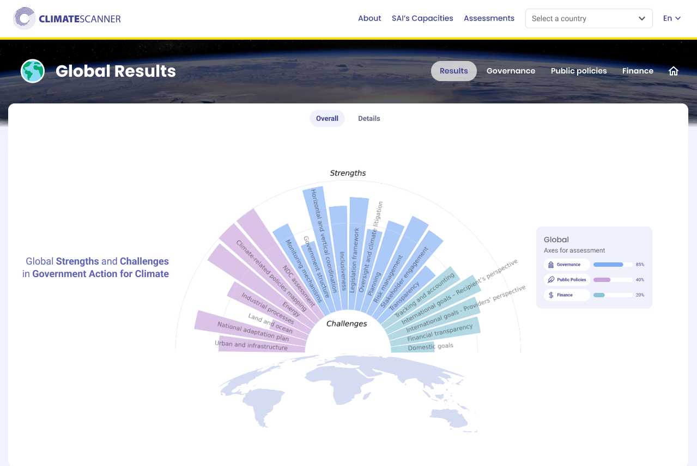
Protótipo
Notes:
The purposes of this slide are to:
Introduce the web platform we are developing for gathering and processing data collected by auditors during their assessments and communicate results to society
Explain that this is a prototype, not the final version
Inform that the view presented here is from the global picture: a sun chart (stylized radar chart) that shows the average level of implementation of each component across the world
Explain that this allows users, at a quick glance, to identify those components with the highest implementation (strengths) and those with lowest implementation (challenges)

Slide 15
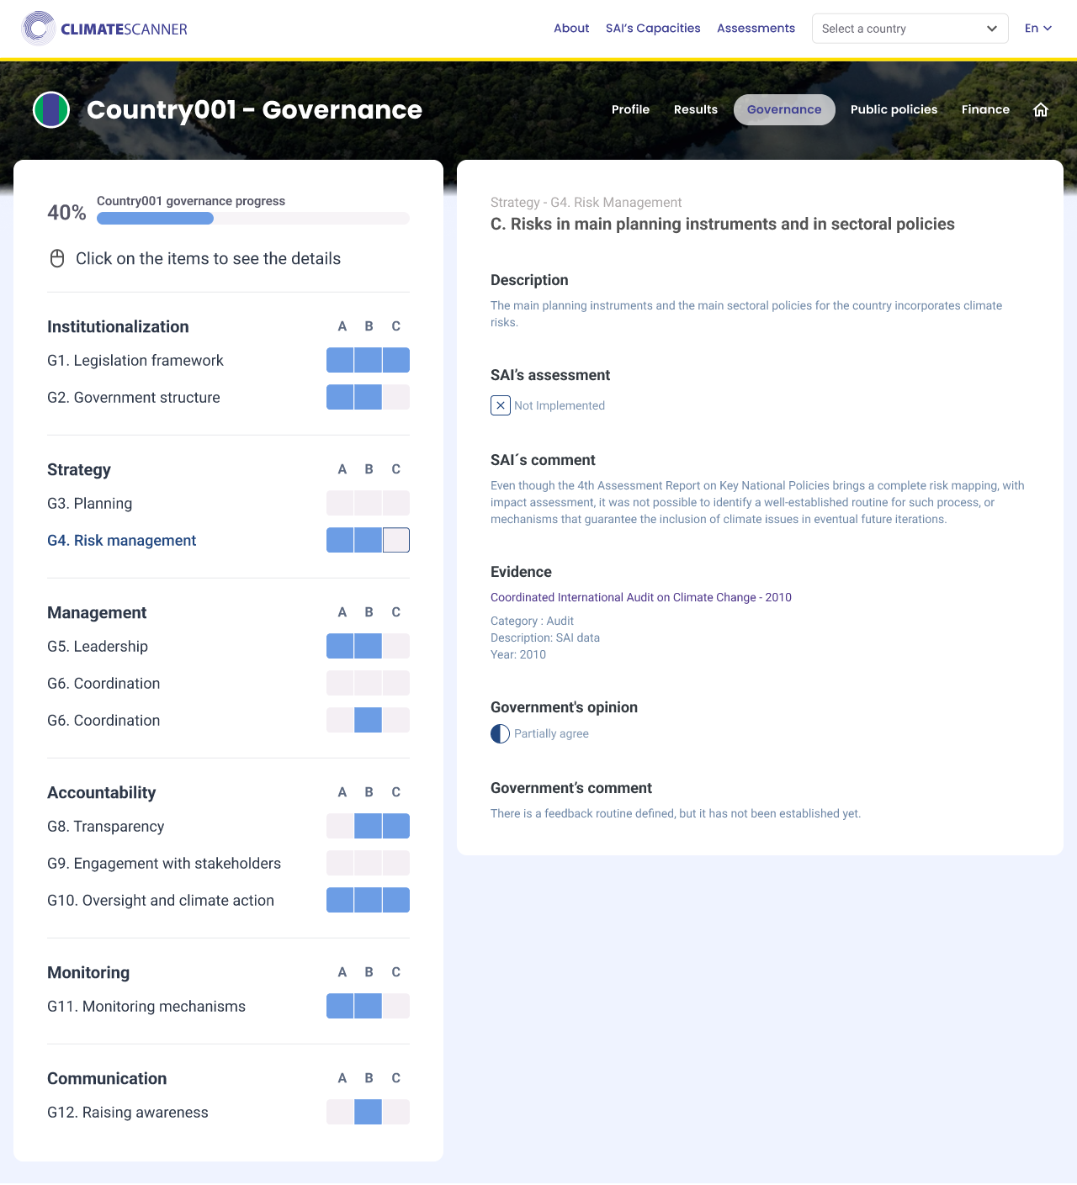
Protótipo
Notes:
The purposes of this slide are to:
Show the national visualization of results (this screen shows results for the governance axis)
Explain that users will be able to click on each item and check the details of the assessment for that item
If the audience of the presentation is the government, it is important to highlight where they participate in this process:
By providing information and evidence (field “evidence”). Please note the audit team will be the one receiving the evidence from government and feeding it into the web platform
If your SAI intends to invite the government to give their opinion on your assessment, then they also participate by providing comments (fields “government’s opinion” and “government’s comments”). In the case of the governments’ opinion and comments, unlike in the evidence field, your SAI will have to invite the government to directly access the platform and manifest their opinions and comments.
* Please note that this slide contains an animation that makes the screen slide upwards, showing the contents of the bottom of the screen, including the fields “government’s opinion” and “government’s comments”. if your SAI does not plan on sending the assessments to the government for their manifestation, you are advised to deactivate this animation. You can do that by clicking on the tab “Animations” on the top menu of this window and selecting the image of the screen. Then, click on “Animation Pane”, under “Advanced Animation”. A menu should open to the right. Click on the corresponding animation and select “Remove”. The fields “government’s opinion” and “government’s comments” will remain still and offscreen.
Here are some other details to share:
When the user clicks on an item, the window to the right will open showing details for that item
User will be able to see whether the item was considered as “implemented” or “not implemented” by the SAI
This window also shows any extra comments or details the auditors responsible for the assessment provided
It will be possible to check the evidence auditors used as support for their assessment
The SAI also has the option to ask for the governments’ comments on the SAI’s assessment. This is an opportunity for the government to manifest their opinion on the matter and provide a second view, if they do not fully agree with the SAI’s assessment

Slide 16
FIM?

